Slide 1
Lecture 7
D&D Chapter 7 & 8 Composite Classes and enums

Slide 2
Goals
By the end of this lesson, you should
Know how to make and use composite classes
consider the functionality required to decide which class it should go into
Know how to implement and use constants
Enums (enumerators)
Know how to declare and use a simple enum
Know how to declare and use a type enum.

Slide 3
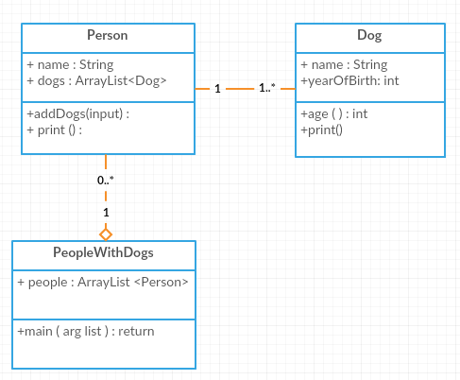
Class Example
Composite classes
Constants and enums
Summary
I want to have a class of Person from which I can instantiate various person objects (ie different people). Each person has a number of dogs – of class type Dog.
I want these person objects to be held in a People collection
Here’s the UML class diagram.
Note: The Dog class we will use in this lecture is different from the one used in Lecture 4.

Slide 4
PeopleWithDogs
public class PeopleWithDogs {
public static void main(String[] args) {
ArrayList<Person> people = new ArrayList<Person>();
String name = "";
Scanner input = new Scanner(System.in);
System.out.println("Enter a person's name");
name = input.next();
while (! name.toUpperCase().equals("N")){
Person person = new Person(name);
people.add(person);
person.addDogs(input);
System.out.println("Enter another person, or N to finish");
name = input.next(); } …
Note: We first make the Person, add it to the ArrayList, then call the person.addDogs() method for their dogs to be added.
Could you swap any of these statements without effect?
Composite classes
Constants and enums
Summary

Slide 5
PeopleWithDogs
public class PeopleWithDogs {
public static void main(String[] args) {
….
// get the objects to print themselves
for(Person p: people){
p.print();
}
}
Its good software engineering for objects to look after their own functionality… so the Person objects can print themselves – and as we will see, the Person objects, in turn, ask the Dog objects to print themselves.
In this spirit, every Java object has a toString() method, which returns information about the object as a String. When we write our own classes, we can either implement our own version of toString() or make do with the one inherited from the Object class.
Composite classes
Constants and enums
Summary

Slide 6
Person (1)
Note how the Person Class uses the Dog class:
import java.util.ArrayList;
import java.util.Scanner;
public class Person {
private ArrayList<Dog> dogs;
private String name;
// constructor
public Person(String name){
dogs = new ArrayList<Dog>();
this.name = name;
}
// getters and setters for the name
…
The Person class has
- two attributes: a name and an ArrayList of type Dog.
- one constructor that initializes the ArrayList and sets the name
Composite classes
Constants and enums
Summary

Slide 7
Person(2) – general methods
public void addDogs(Scanner input){
String name;
System.out.println("Enter their dog's name");
name = input.next();
while (!name.toUpperCase().equals("N")){
Dog dog = new Dog (name);
dogs.add(dog);
System.out.println("Enter another dog or N to stop");
name = input.next();
};
}
public void print(){
System.out.println("Owner " + name );
for(Dog d: dogs){
d.print();
}
}
…
The functionality of these methods could have been in the PeopleWithDogs class, but it is better for an object to look after itself
Composite classes
Constants and enums
Summary

Slide 8
A new Dog class
import java.time.*;
public class Dog {
// instance variables
private String name;
private int yearOfBirth;
//getters and setters for name and year of birth
…
// a public print() method public void print(){
System.out.println(" Dog " + name );
}
// general methods
public int age(){
return LocalDate.now().getYear() - yearOfBirth;
}
// constructors
…
}
Composite classes
Constants and enums
Summary
Exercise: Write some code that uses this method!

Slide 9
Composite Classes
PeopleWithDogs is a composite class it consists of itself (just main()) and the ArrayList that contains Person objects
Person Class is a composite class – it is made of itself and an ArrayList of Dog objects
Easy!
write the Dog Class
write the Person Class to include the Dogs
write the PeopleWithDogs to include the Persons objects
If you write them in the opposite order you will get lots of ‘undefined’ compiler messages while things are not yet written – this is fine as long as you remember, ok, this will resolve itself when I have written the next bit.
Composite classes
Constants and enums
Summary

Slide 10
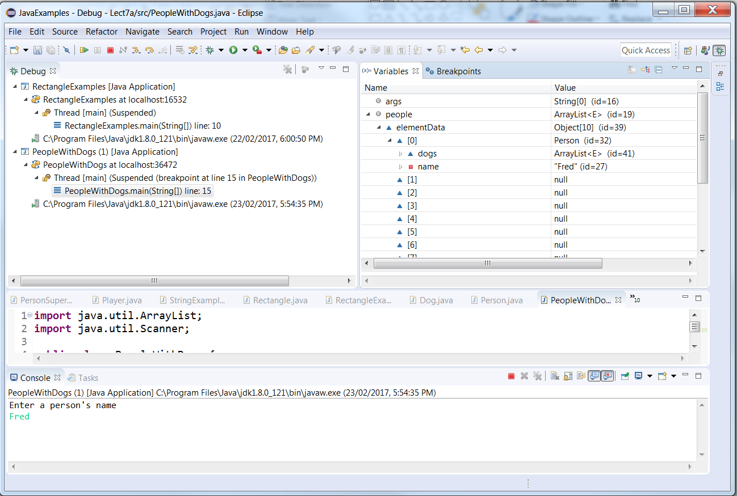
Debug
Composite classes
Constants and enums
Summary
Note how the ArrayList people has more than just element 0, even though we haven’t added more than one Person object yet. ArrayList is trading off memory against speed here: By providing a few extra elements from the outset, it doesn’t need to create the individually whenever we add a new element to the ArrayList, which would be quite inefficient!

Slide 11
Constants
Composite classes
Constants and enums
Summary
Most languages have constants.
Constants are variables that cannot change (that’s an oxymoron!). E.g., PI = 3.14159…
Defining a constant in Java is a matter of using the keyword final. By convention the constant’s name is in ALLCAPS
final int DAYSINWEEK = 7;
You can use a constant anywhere you would a variable except to receive a value – you cannot change its value because it’s constant:
DAYSINWEEK = 9; // this is a compile error.

Slide 12
enums
Composite classes
Constants and enums
Summary
enums (aka enumerators) are also constant – but they are a set of constants.
public enum Days{SUNDAY,MONDAY,TUESDAY,WEDNESDAY,….};
There is now a type Days which can store the constants SUNDAY, MONDAY, etc.
Enums could be thought of as an array of constants. Originally, enums had an integer value starting at 0 that the programmer could use (like an array index). Now, most
languages hide it.
Enumerate means to list things 1 by 1
1 Tidy room
2 Do home work
3 Cook dinner

Slide 13
Guessing Game
Composite classes
Constants and enums
Summary
import java.util.Scanner;
public class GuessingGame {
public enum Status {HIGHER,LOWER,RIGHT};
public void LetsPlay(){ SimpleEnum(); TypeEnum(); } …
}
Notice the enum is specified at the class level. You can’t specify an enum inside a method.

Slide 14
Const and simple enum
Composite classes
Constants and enums
Summary
private void SimpleEnum() {
input = new Scanner(System.in);
final int MAX_TRIES = 7;
int tries = 0;
int randomNumber = (int) (Math.random()*10) + 1;
Status status;
System.out.println("I have thought of a number between 1 and 10"); System.out.printf("Input your best guess – you are allowed a maximum of %d guesses \n", MAX_TRIES);
do {
int guess = input.nextInt();
if (guess < randomNumber)
status = Status.HIGHER;
else if (guess > randomNumber)
status = Status.LOWER;
else
status = Status.RIGHT;
System.out.println("Go " + status);
tries++;
} while (status != Status.RIGHT && tries < MAX_TRIES);
if (status != Status.RIGHT) {
System.out.println("Sad, too many tries, haven't you played this before?");
}
}

Slide 15
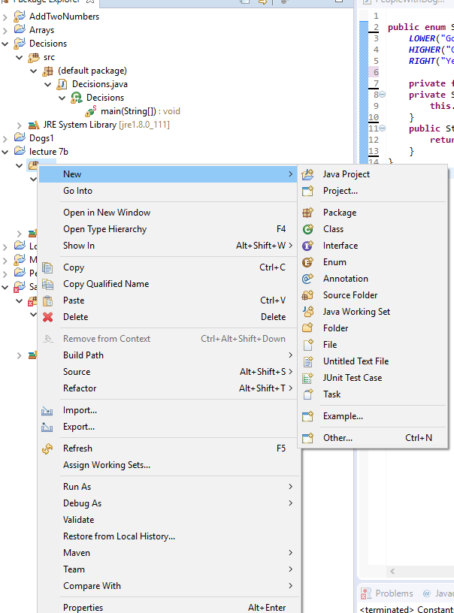
enum Type
Composite classes
Constants and enums
Summary
With an enum type, you can associate other attributes with each enumerated value – all constants! (think of it as a kind of 2D array)
First add a new enum .java file to your project (File/New/enum
Add the enum list - you can have more than one associate value and they can be different types, e.g., JANUARY("Holidays", 31)
The constructor is required – a variable and matching this.xxxx for each parameter.
The getMessage() method returns the value corresponding to the enum parameter.
public enum StatusPlus {
LOWER("Go Lower"),
HIGHER("Go Higher"),
RIGHT("Yes, you got it right!");
// Constructor
private final String message;
private StatusPlus(String message) {
this.message = message;
}
// Return the message value // for an enum
public String getMessage(){
return message;
}
}

Slide 16
Guessing Game with enum type
Using the enum type
It’s not a class so you don’t instantiate it. Why?
The whole point in instantiating classes is so you can customise the instance variables in the objects of the class with values specific to each object.
There is is no point in instantiating an enum since it is all constant
Quite a few of the Java utility classes have enums (e.g., time has Days, months).
Sometimes making your own enum can make code much cleaner and easier to read, sometimes they are just extra work. And you have to be confident that it isn’t going to change (or at least not often).
As a rule of thumb: If you expect to use the values of the enum often and in many places, have an enum. If the use of the enum is a one-off in a single method or tiny class, don’t.
Composite classes
Constants and enums
Summary

Slide 17
Guessing Game with enum type
private void TypeEnum(){
int randomNumber = (int) (Math.random()*10) + 1;
int tries = 0;
StatusPlus statusPlus;
final int MAX_TRIES = 5;
System.out.println("I have thought of another number between 1 and 10");
System.out.println("Let's have another go - you are only allowed 5 tries this time !");
do{
int guess = input.nextInt();
if (guess < randomNumber)
statusPlus = StatusPlus.HIGHER;
else if (guess > randomNumber)
statusPlus = StatusPlus.LOWER;
else
statusPlus = StatusPlus.RIGHT;
System.out.println(statusPlus.getMessage());
tries++;
} while (statusPlus != StatusPlus.RIGHT && tries < MAX_TRIES); if (statusPlus != StatusPlus.RIGHT) {
System.out.println("Sad, too many tries, haven't you played this before?");
}
input.close();
}
Composite classes
Constants and enums
Summary

Slide 18
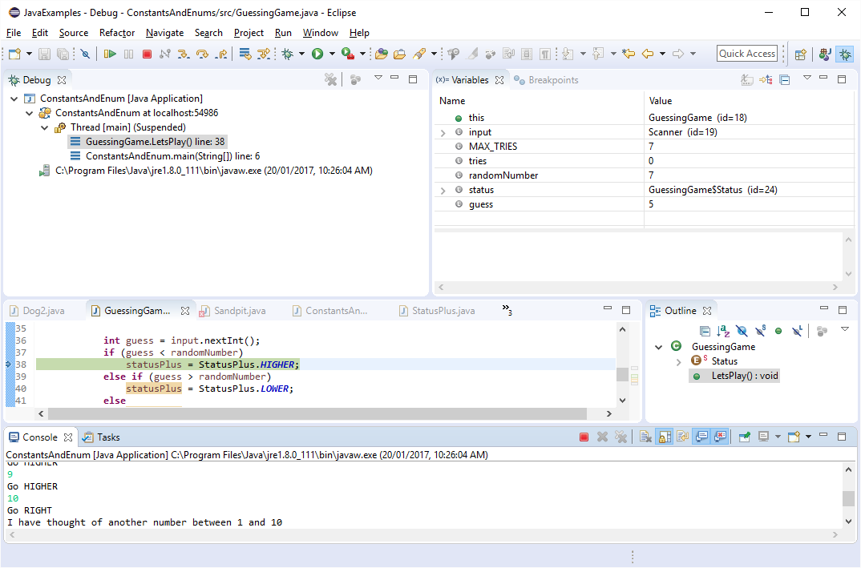
Debug
Composite classes
Constants and enums
Summary
The constant and enum don’t show in the debugger but their variables do

Slide 19
What do we know
Composite classes
Constants and enums
Summary
Classes can be made up of other classes
Design all the classes
Decide where the functionality goes
Develop each class
Include object variables the higher class of the lower class
Constants are variables whose value cannot be changed
Their names (by convention) are CAPITAL
They can be used in the same way as any other variable except they cannot be on the right-hand side of an assignment (i.e. receive a value)
enums – enumerators are a set of constants
enum types – are a set of constants with associated fields.
They are usually in their own file
They must have a constructor
They must have a get for each field

Slide 20
Resources
Composite classes
Constants and enums
Summary
Composite classes
D&D chapter 8
https://docs.oracle.com/javase/tutorial/java/javaOO/
enums
D&D sections 5.8 and 8.9
https://docs.oracle.com/javase/tutorial/java/javaOO/enum.html

Slide 21
Next Lecture
D&D Chapters 9
Objects (3) Inheritance

